Slide 1

Structure and Functional Biology
First Week online Lecture (2/3)
Dr. Farrukh Jamil

Slide 2
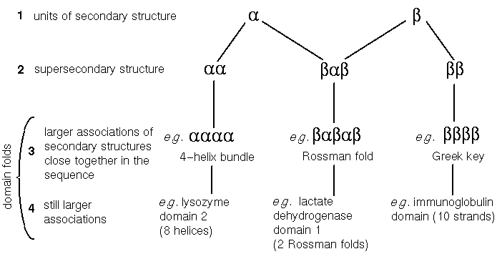
Domains in Tertiary structures (Last lec revision)

Slide 3
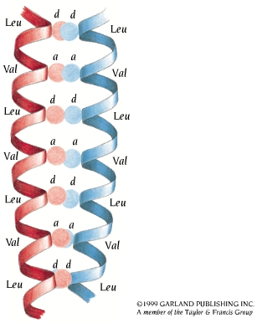
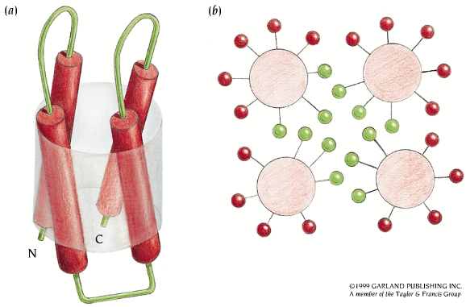

Helix folds
α α α α α α α

Slide 4
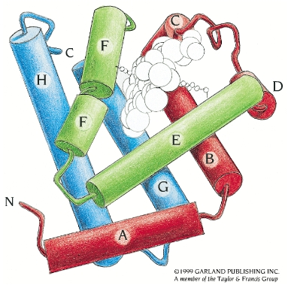
Helix folds
α⁸

Slide 5
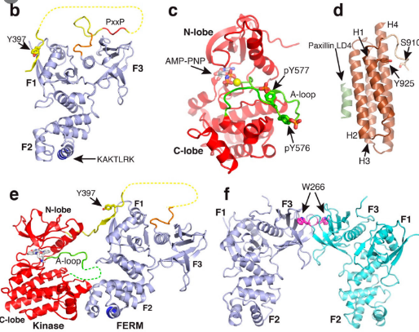
Quiz/Work Sheet
Identify the different domains in the protein.

Slide 6
Assignment
Find one example of each four domains given in slide 3 and 4.
What is difference between peptides and proteins.

Slide 7
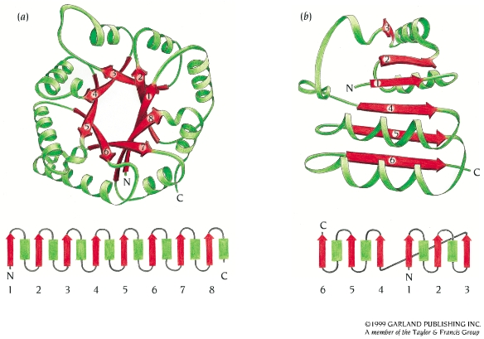
Alpha/Beta Structure
Alpha/beta domains are found in many proteins.
The most regular and common domain structures consist of repeating beta-alpha-beta super-secondary units, such that the outer layer of the structure is composed of alpha helices packing against a central core of parallel beta sheets. These folds are called alpha/beta, or wound alpha beta.
There are three main classes
of α/β proteins (β−α−β):
TIM barrel
Rossman Fold (open sheets)
Horseshoe fold

Slide 8
TIM Barrel
A core of twisted parallel β strands arranged close together, like the staves of a barrel.
Here shows a closed barrel exemplified by schematic and topological diagrams for the enzyme triosephosphate isomerase.
The β−α−β motifs are connected sequentially, and
α helices are on the same side of the β sheet.

Slide 9
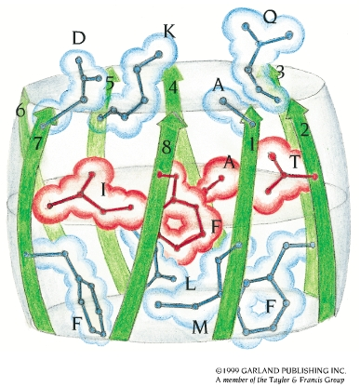
Properties of TIM Barrel
α/β-barrel has been found in more than 15 proteins.
Most of them are enzymes with completely different amino acid sequences and different functions.
Branched hydrophobic side chains dominate the core of this class of proteins.
In most α/β-barrel structures the eight β strands of the barrel enclose a tightly packed hydrophobic core formed entirely by side chains from the β strands. The core is arranged in three layers, with each layer containing four side chains from alternate β strands. The schematic diagram shows this packing arrangement in the α/β barrel of the enzyme glycolate oxidase.

Slide 10
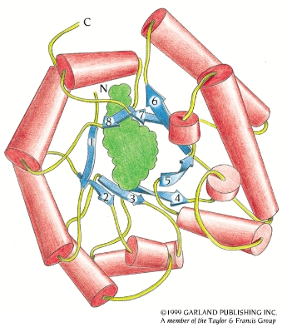
Methylmalonyl-coenzyme A Mutase
One exception, the inside of the barrel methylmalonyl-coenzyme A mutase is lined by small hydrophilic side chains (serine and threonine) from the β strands, which creates a hole in the middle where one of the substrate molecules, coenzyme A (green), binds along the axis of the barrel from one end to the other.

Slide 11
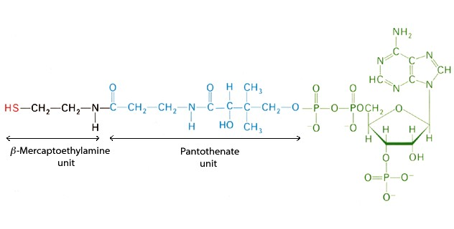
Coenzyme A (CoA)

Slide 12
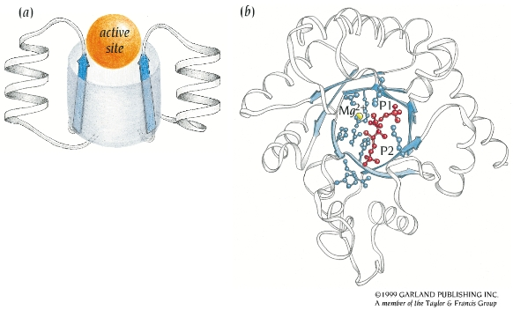
α/β Barrel Active Site
The active site in all α/β barrels is a pocket formed by the loop regions that connect the carboxy ends of the β strands with the adjacent α helices (a).
A view from the top of
the barrel of the active site of
the enzyme RuBisCo (ribulose
bisphosphate carboxylase),
which is involved in CO2
fixation in plants (b).

Slide 13
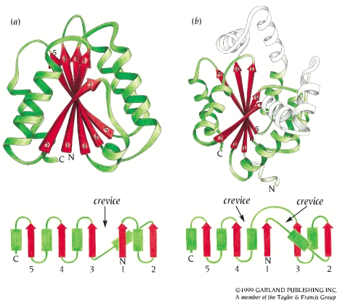
Open α/β Sheet
Open twisted β sheet is surrounded by α-helices on both sides of the β-sheet.
Examples of different types of open twisted α/β structures (a) the FMN-binding redox protein Flavodoxin and (b) the enzyme adenylate kinase, which catalyzes the reaction AMP + ATP <=> 2ADP.

Slide 14
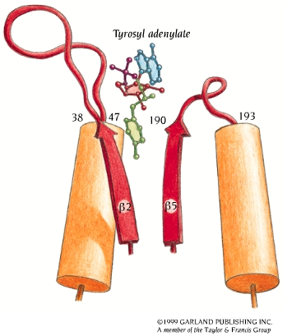
Active Site of Open α/β Sheet
There are always two adjacent β-strands on opposite sides of a β-sheet. One of the loops from one of these two β-strands goes above the β-sheet, whereas the other loop goes below, which creates a crevice outside the edge of the β-sheet between two loops.
Almost all binding sites in this class of proteins are located in crevices at the carboxy end of the β sheet.
A schematic view of the active site of tyrosyl-tRNA synthetase. Tyrosyl adenylate,
the product of the first reaction catalyzed by the enzyme, is bound to two loop
regions: residues 38 - 47, which form the loop after β strand 2, and residues 190 - 193,
which form the loop after β strand 5. The tyrosine and adenylate moieties are bound
on opposite sides of the β sheet outside the carboxy ends of β strands 2 and 5.

Slide 15
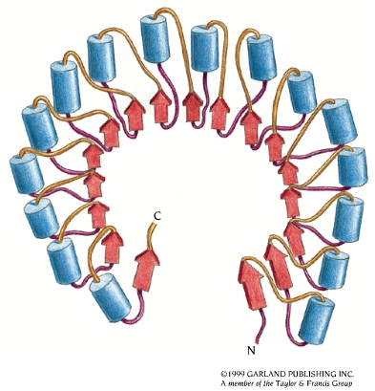
α/β–horseshoe Fold
α/β –horseshoe Fold is formed by amino acid sequences that contain repetitive regions of a specific pattern of α helices and β-strands. The β strands form a curved parallel β sheet with all the α helices on the outside.
Schematic diagram of the structure of the ribonuclease inhibitor. The molecule, which is built up by repetitive β−loop-α motifs, resembles a horseshoe with a 17-stranded parallel β sheet on the inside and 16 α helices on the outside.

Slide 16
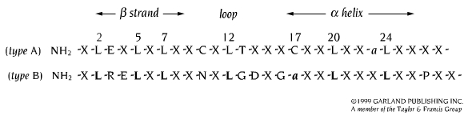
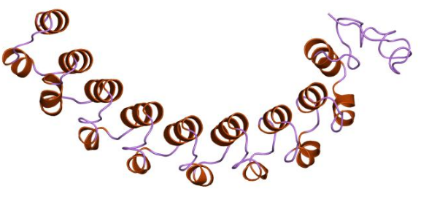
Leucine-rich Motifs
Consensus amino acid sequence and secondary structure of the leucine-rich motifs of type A and type B. “X” denotes any amino acid; “a” denotes an aliphatic amino acid. Conserved residues are shown in bold in type B.
In the ribonuclease inhibitor, leucine residues 2, 5, and 7 from the β strand pack against leucine residues 17, 20, and 24 from the α helix as well as leucine residue 12 from the loop to form a hydrophobic core between the β strand and the α helix.

